Slide 1
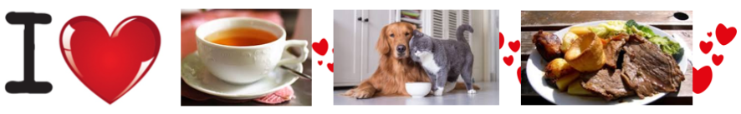
3 A
THINGS I LOVE ABOUT BRITAIN

Slide 2
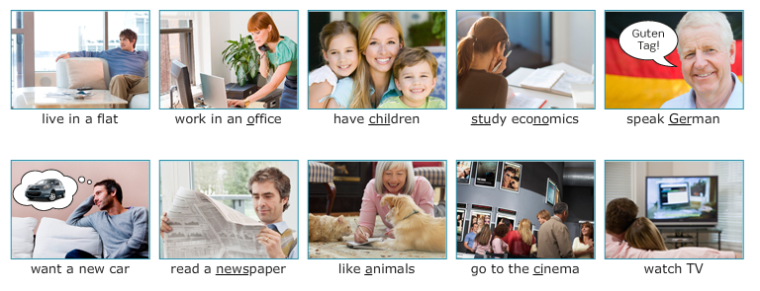

Slide 3
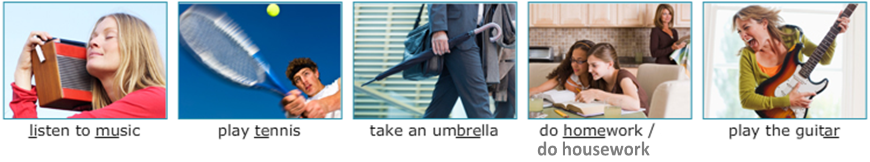
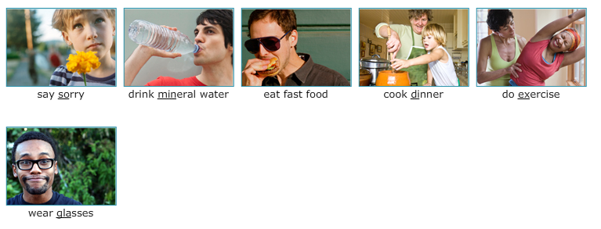

Slide 4
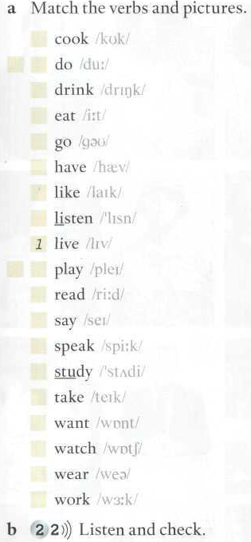

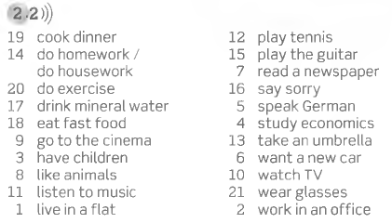
Repeat in a loud voice and memorize all the phrases.

Slide 5
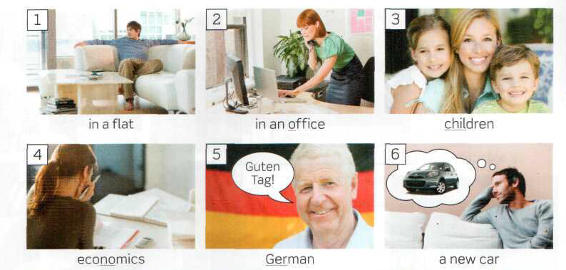
live
work
have
study
speak
want

Slide 6
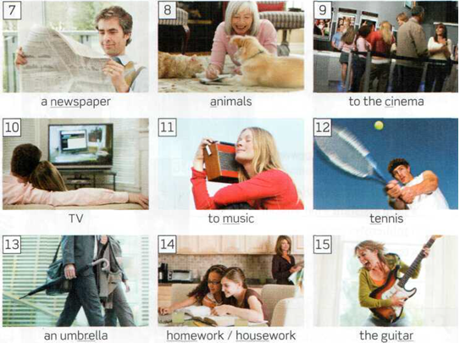
read
love
go
watch
listen
play
take
do
play

Slide 7
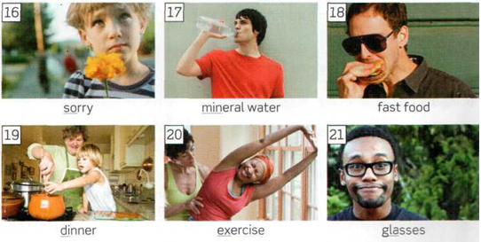
say
drink
eat
cook
do
wear

Slide 8

MEMORIZE THE LIST!!!
Say to the class 6 true things about you, using the verbs on this list.

Slide 9
LIVE in a/an …
WORK in a/an…
HAVE … a…
STUDY engineering / chemical engineering/ systems engineering/ civil engineering/ electronic engineering / electromechanical engineering/mechatronics engineering/industrial engineering/petroleum engineering/architecture
STUDY English/ French/ Italian/ Mathematics, Physics,
SPEAK … / two languages
WANT a/an… to pass an exam/ to travel/
READ a…
LIKE …
COMPLETE THE PHRASES.
Check the phrases you memorized
Say to the class 6 true things about you, using the verbs on this list.

Slide 10
GO to … / GO to the …
WATCH …
LISTEN TO …
TAKE …
COMPLETE THE PHRASES.
Check the phrases you memorized
Say to the class 6 true things about you, using the verbs on this list.

Slide 11
DO …
DO …
DO …
PLAY … /
PLAY the …
COMPLETE THE PHRASES.
Check the phrases you memorized
Say to the class 6 true things about you, using the verbs on this list.

Slide 12
COMPLETE THE PHRASES.
Check the phrases you memorized
SAY …
DRINK …
EAT …
COOK …
WEAR…
Say to the class 6 true things about you, using the verbs on this list.

Slide 13
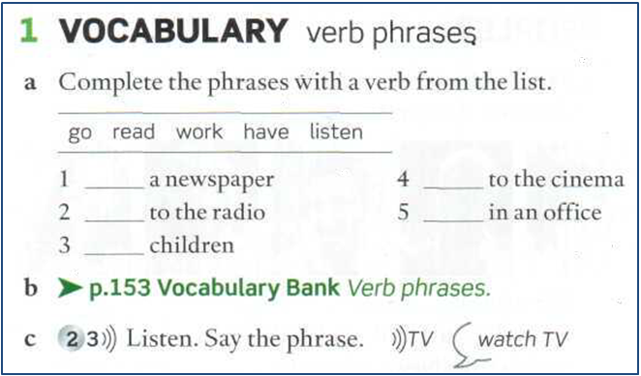
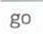
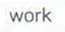
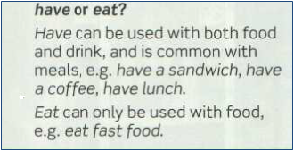

Slide 14
SAY THE PHRASE AND THEN WRITE THE PHRASE
watch tv
1.
2.
3.
4.
5.
6.
7.
8.
9.
10.
play the guitar
drink mineral water
listen to music
wear glasses
have children
eat fast food
go to the cinema
want a new car
do exercise

Slide 15
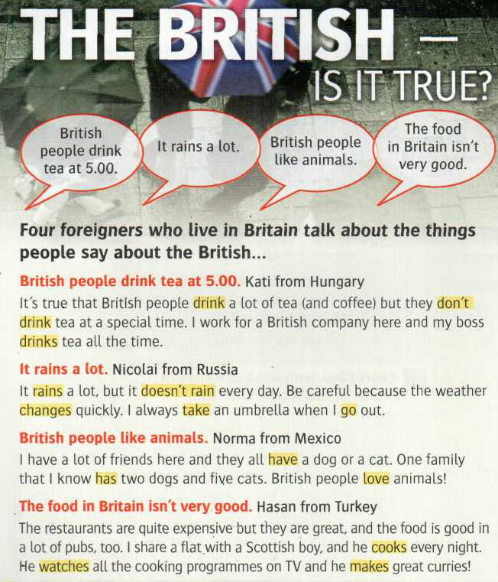
Look at the highlighted verbs. They are in the simple present.
Some are affirmative,
People drink coffee.. (plural)
My boss drinks tea… (Third person singular add an –s)
Some are negative:
They don´t drink tea… (plural form with don´t)
It doesn´t rain… (negative singular with doesn´t)
Now study the simple present in your book at page 128.

Slide 16
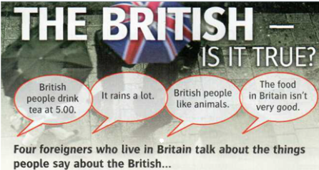

Slide 17
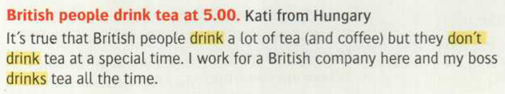
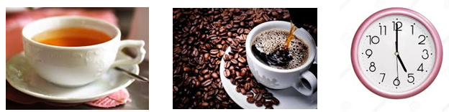
DRINK They drink
They don’t drink
He drinks

Slide 18
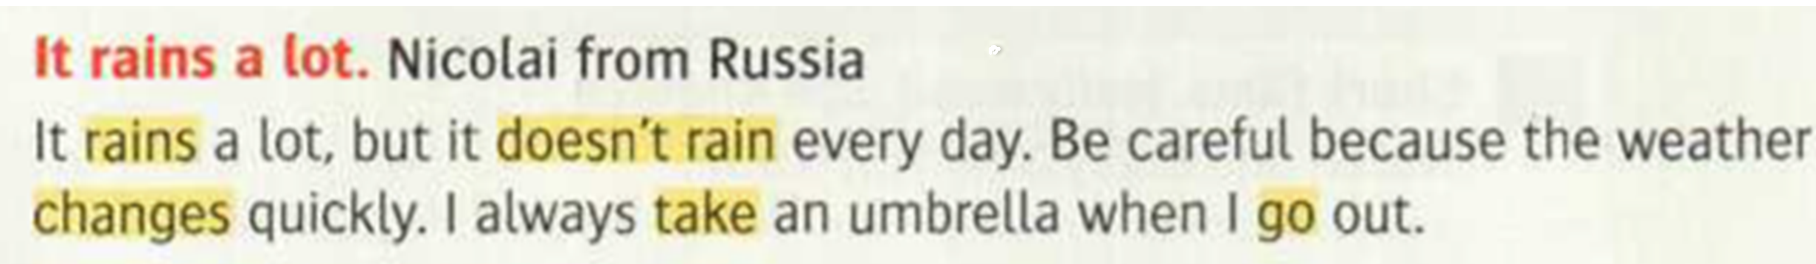
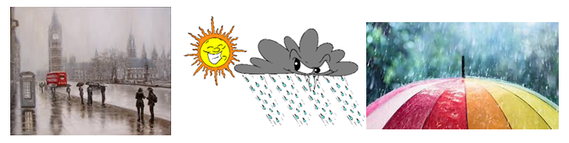
RAIN It rains
CHANGE It (the weather) changes
TAKE I take
GO I go

Slide 19
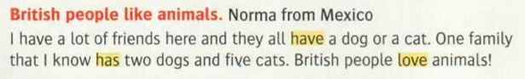
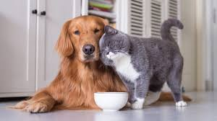
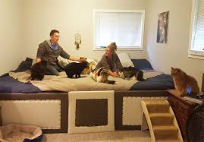
HAVE They have
It has
LOVE They love
She loves

Slide 20
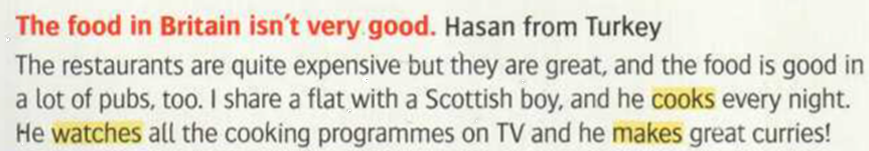
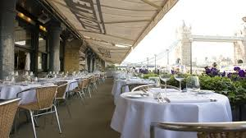
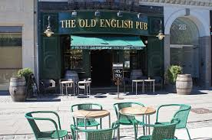
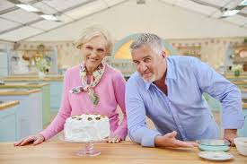
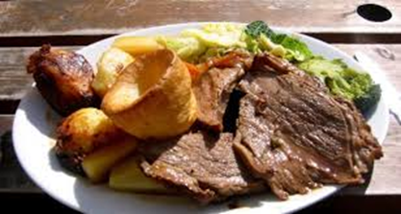
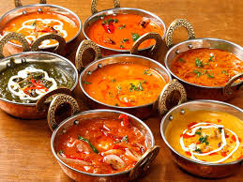
COOK He cooks …
WATCH He watches …
MAKE He makes…

Slide 21
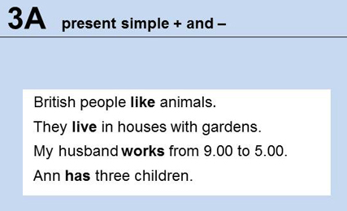
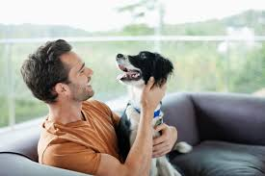
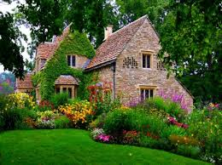
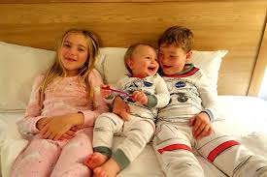
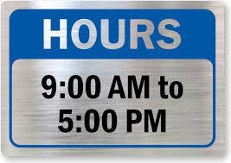
Grammar Bank 128
Listen and repeat!
(Many times)

Slide 22
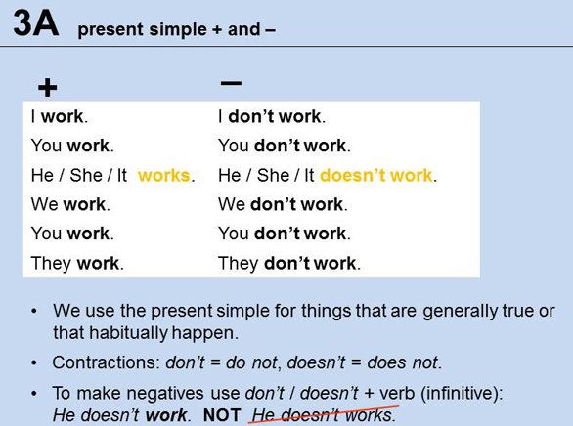

Slide 23
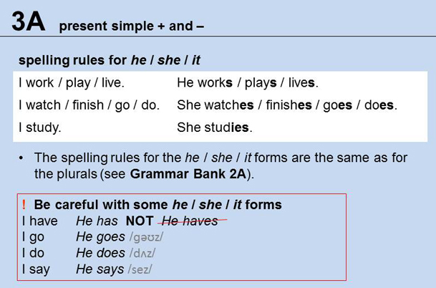

Slide 24
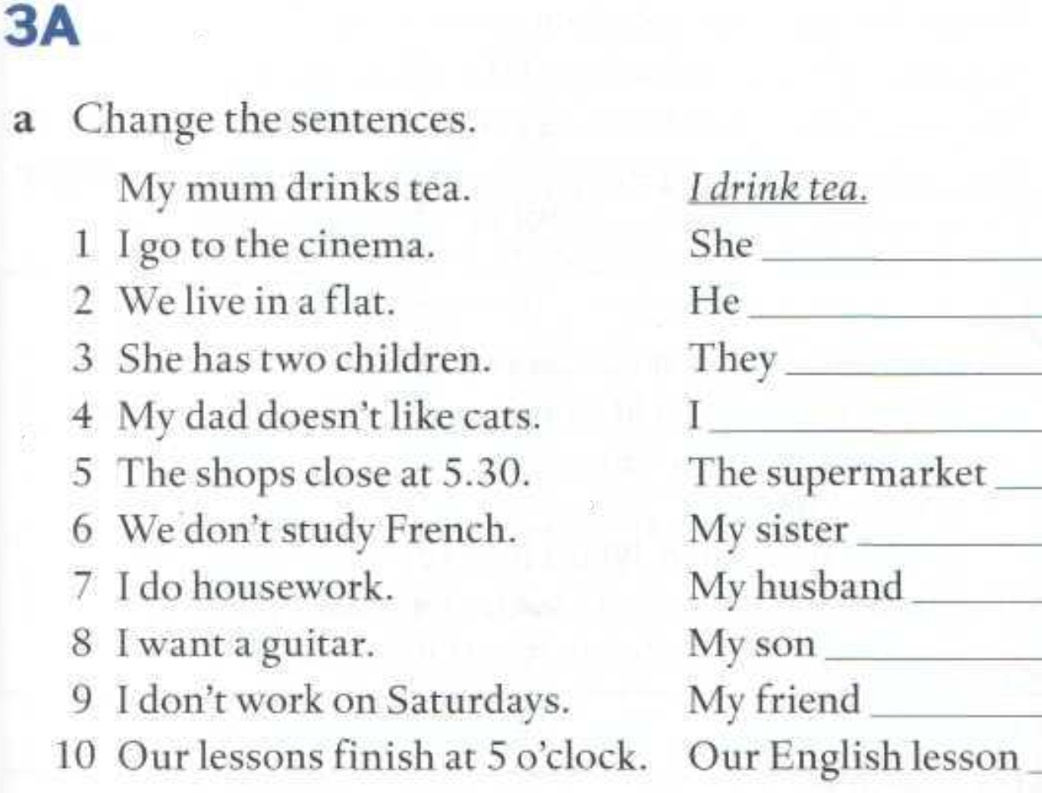
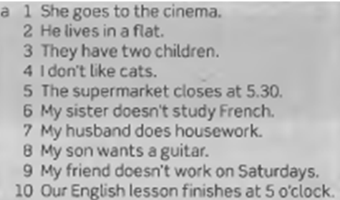
goes to the cinema.
lives in a flat.
have two children.
don’t like cats.
closes at 5.30
doesn’t study French.
does housework.
wants a guitar.
doesn’t work on Saturdays.
finishes at 5 o’clock.

Slide 25
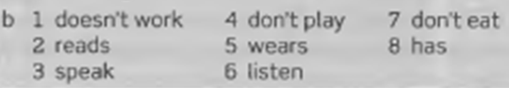
doesn’t work
reads
speak
don’t play
wears
listen
don’t eat
has

Slide 26
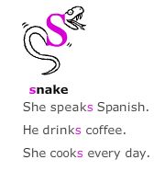
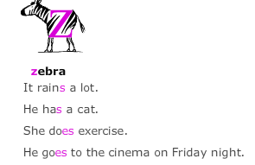
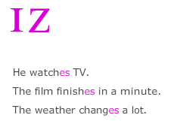
Page 20
PRONUNCIATION: THIRD PERSON SINGULAR
This activity is very important to improve your pronunciation of the third person singular.
Listen and change the sentence
1. I live in a flat. She…
2. I watch TV. He…
3. They play the guitar. She…
4. We wear glasses. He…
5. They finish at 8. It
1. She lives in a flat.
2. He watches TV.
3. She plays the guitar.
4. He wears glasses.
5. It finishes at 8.

Slide 27
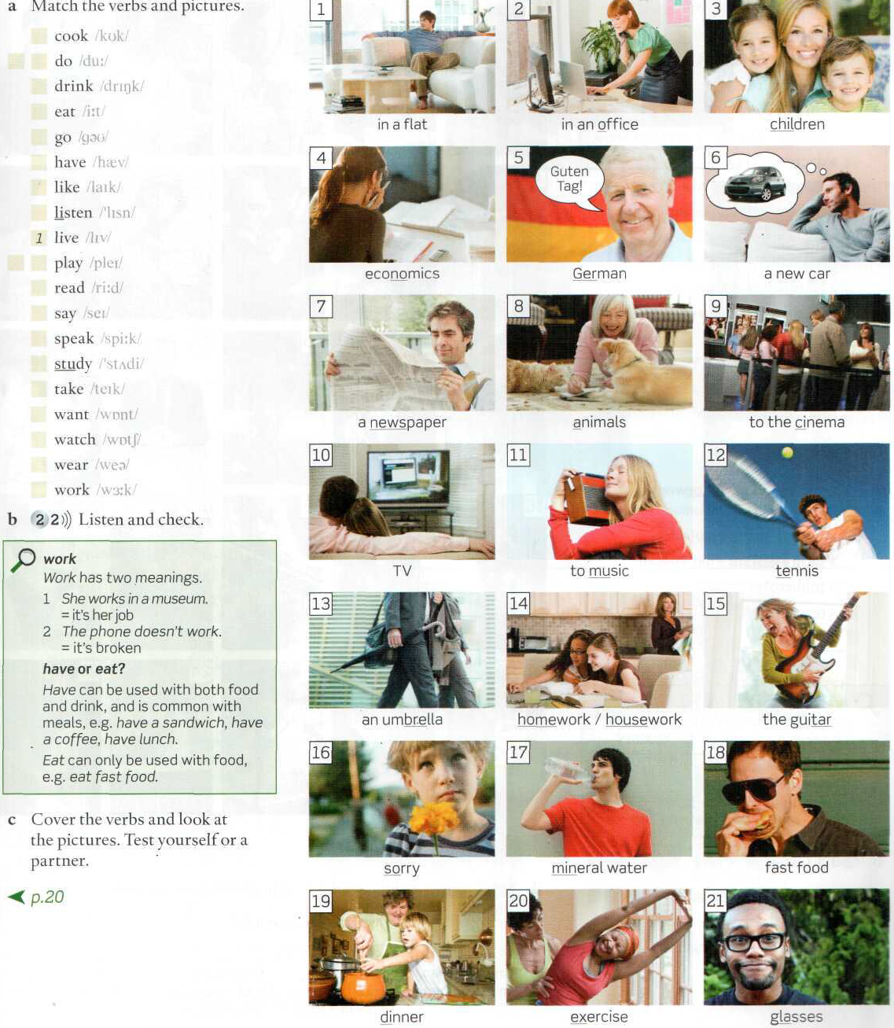
Activity:
Mention three true things about you using simple present affirmative,
3 things using simple present negative,
three things about a friend of yours using the affirmative 3 things using the negative.
Choose from these verbs:
Consider the example:

Slide 28
WB page 17

Slide 31
WB PAGE 17
PRONUNCIATION EXERCISE
PLEASE DO IT! Listen, Repeat and circle

Slide 32
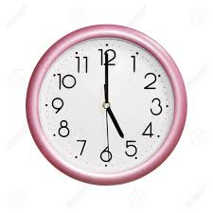
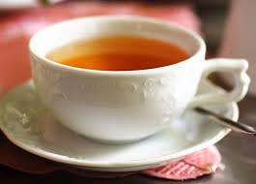
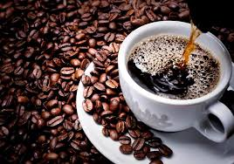
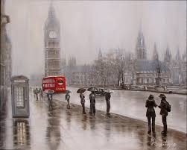
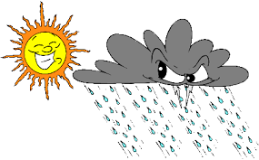
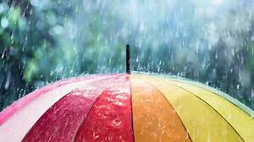
Speak about Britain and the British
Speak about Mendoza and Mendocinian people in the same way.

Slide 33

Speak about Britain and the British
Speak about Mendoza and Mendocinian people in the same way.

Slide 34
Speak about Britain and the British

